Slide 1
feat. Auris, Mystixor

Slide 2
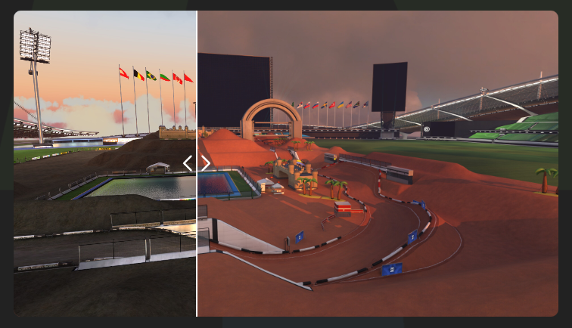
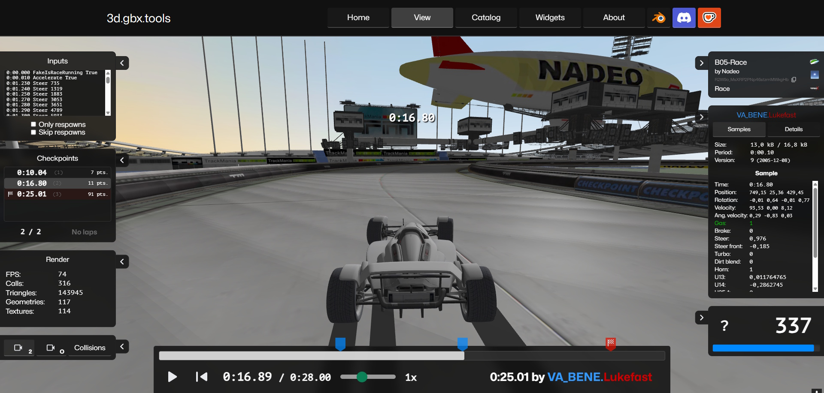
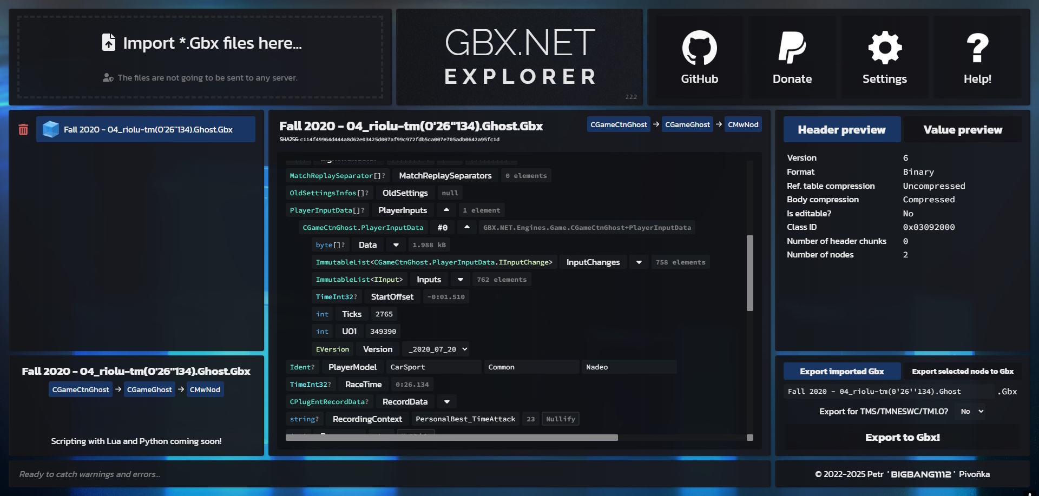
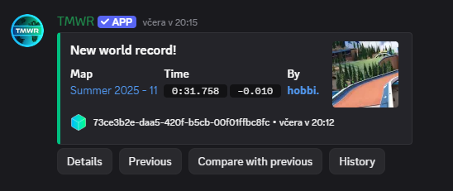
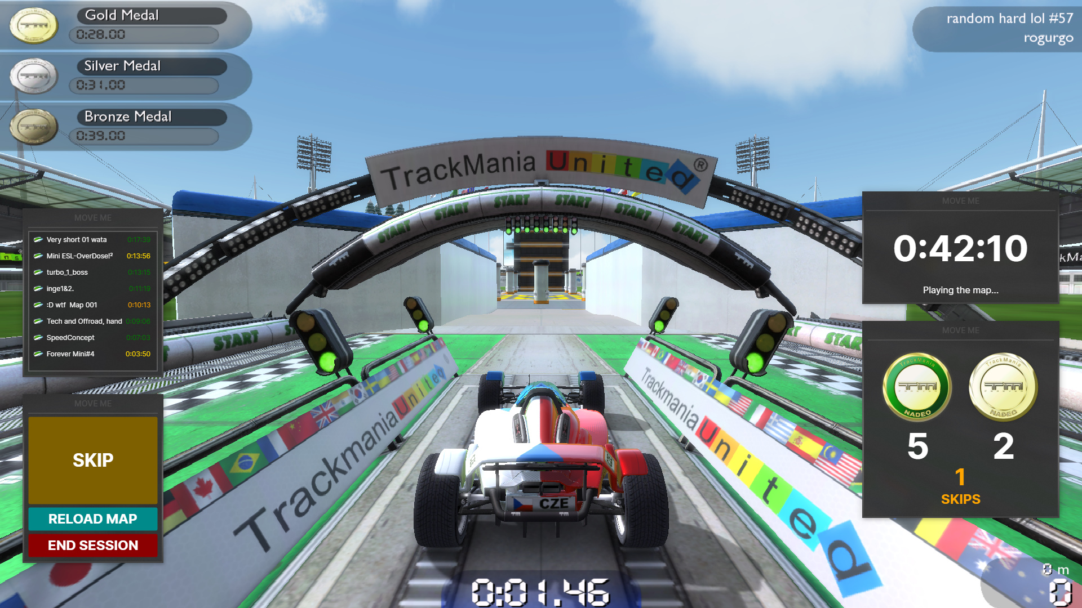
Introduction
Nations Converter
3D Gbx Tools
Gbx Explorer
TMWR Discord bot
Randomizer TMF
Nadeo Envimix (ft. Poutrel)

Slide 3
So what‘s the topic?

Slide 4
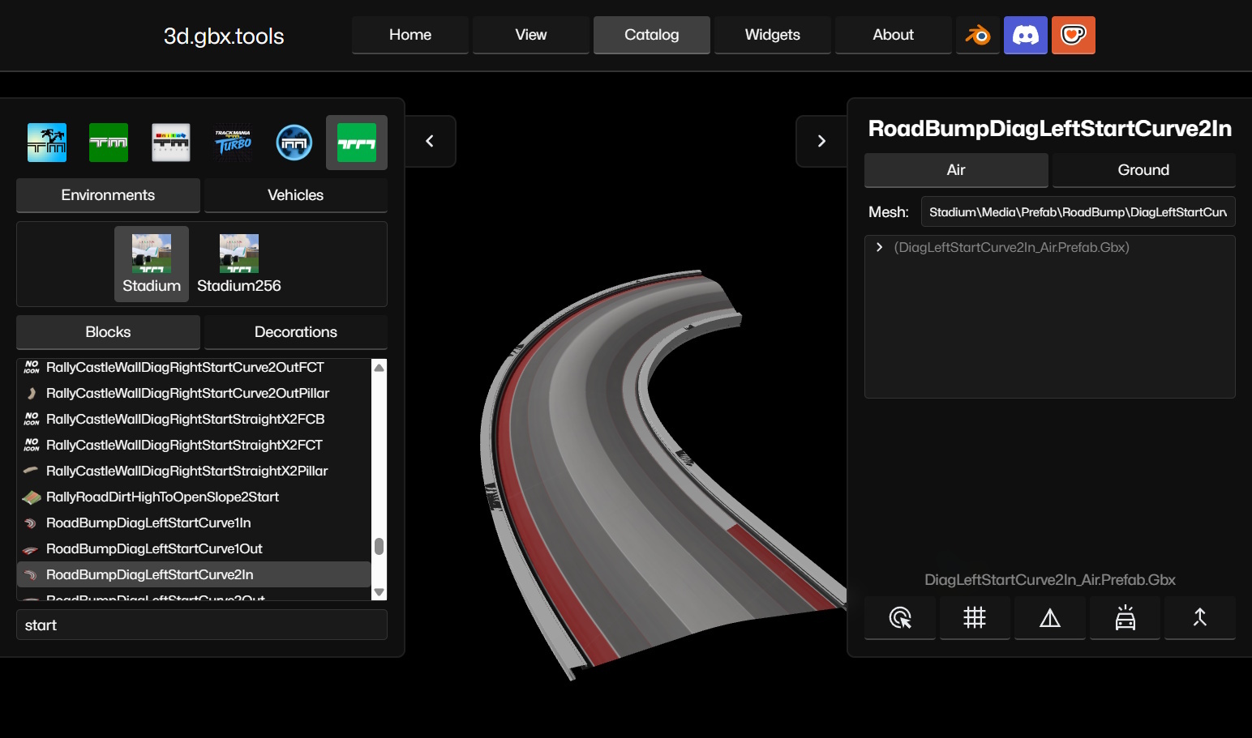

Slide 5
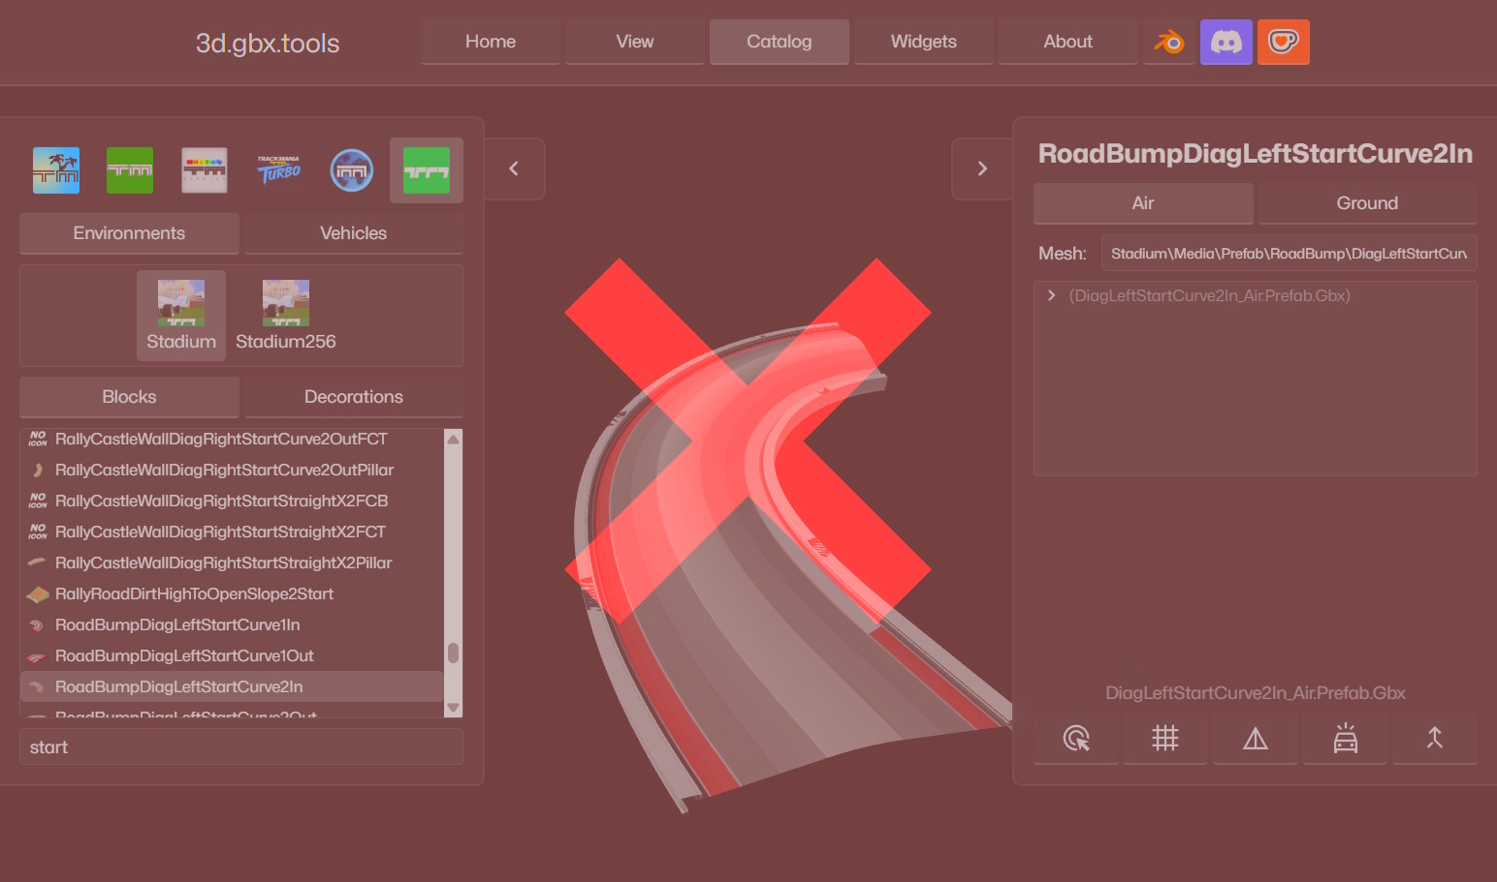

Slide 6
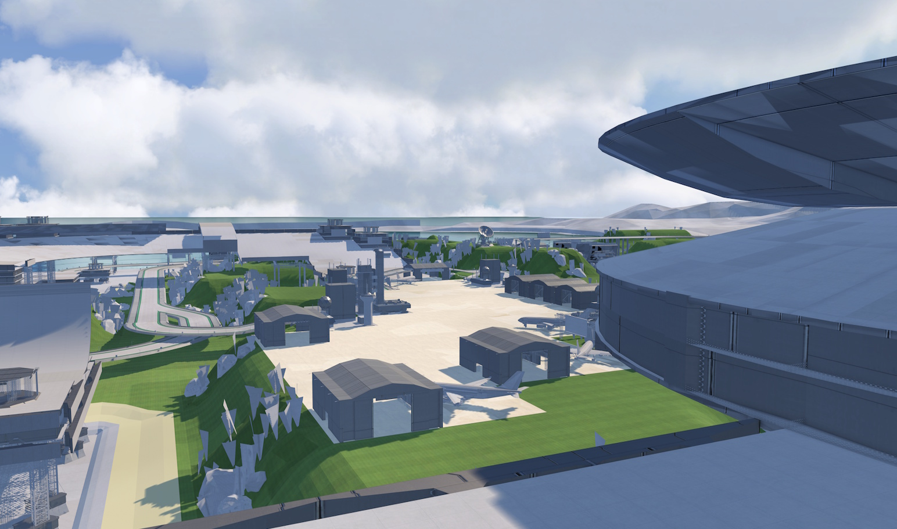

Slide 7
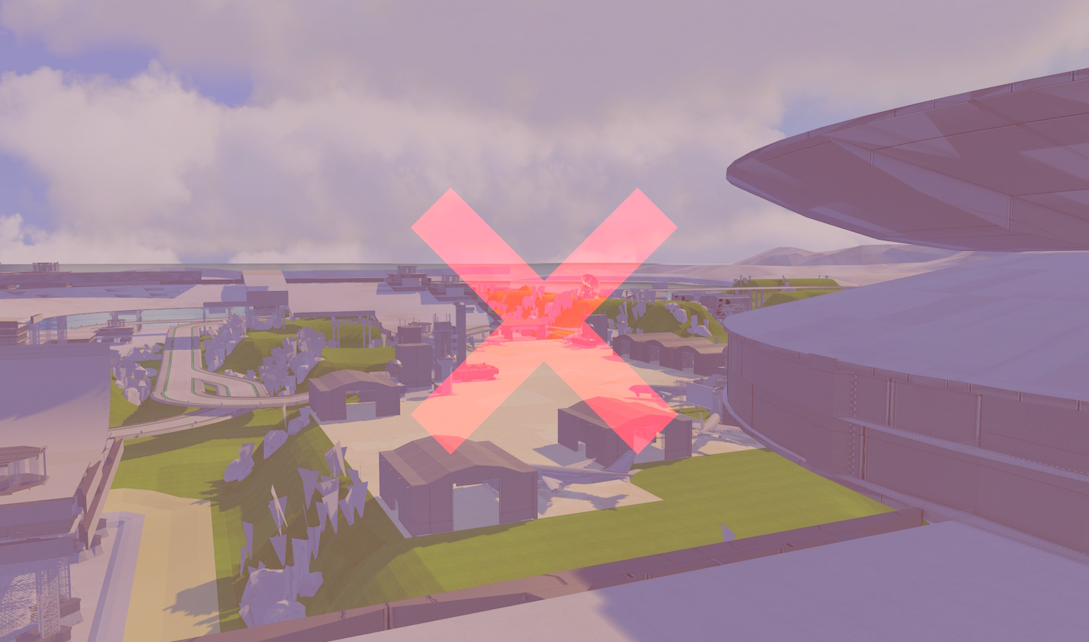

Slide 8
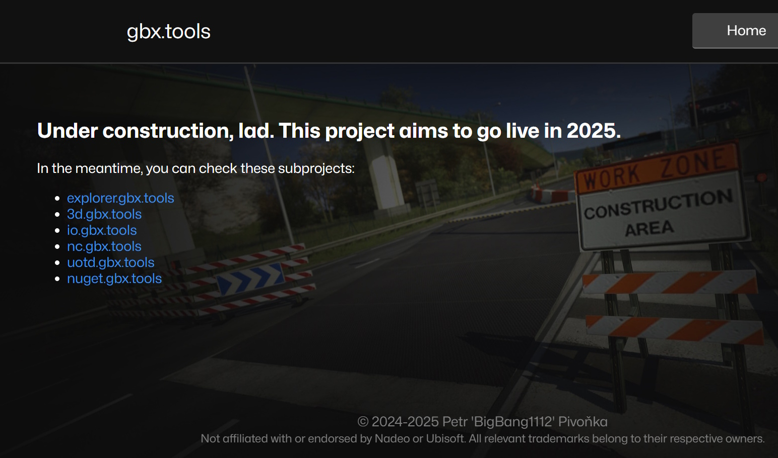

Slide 9
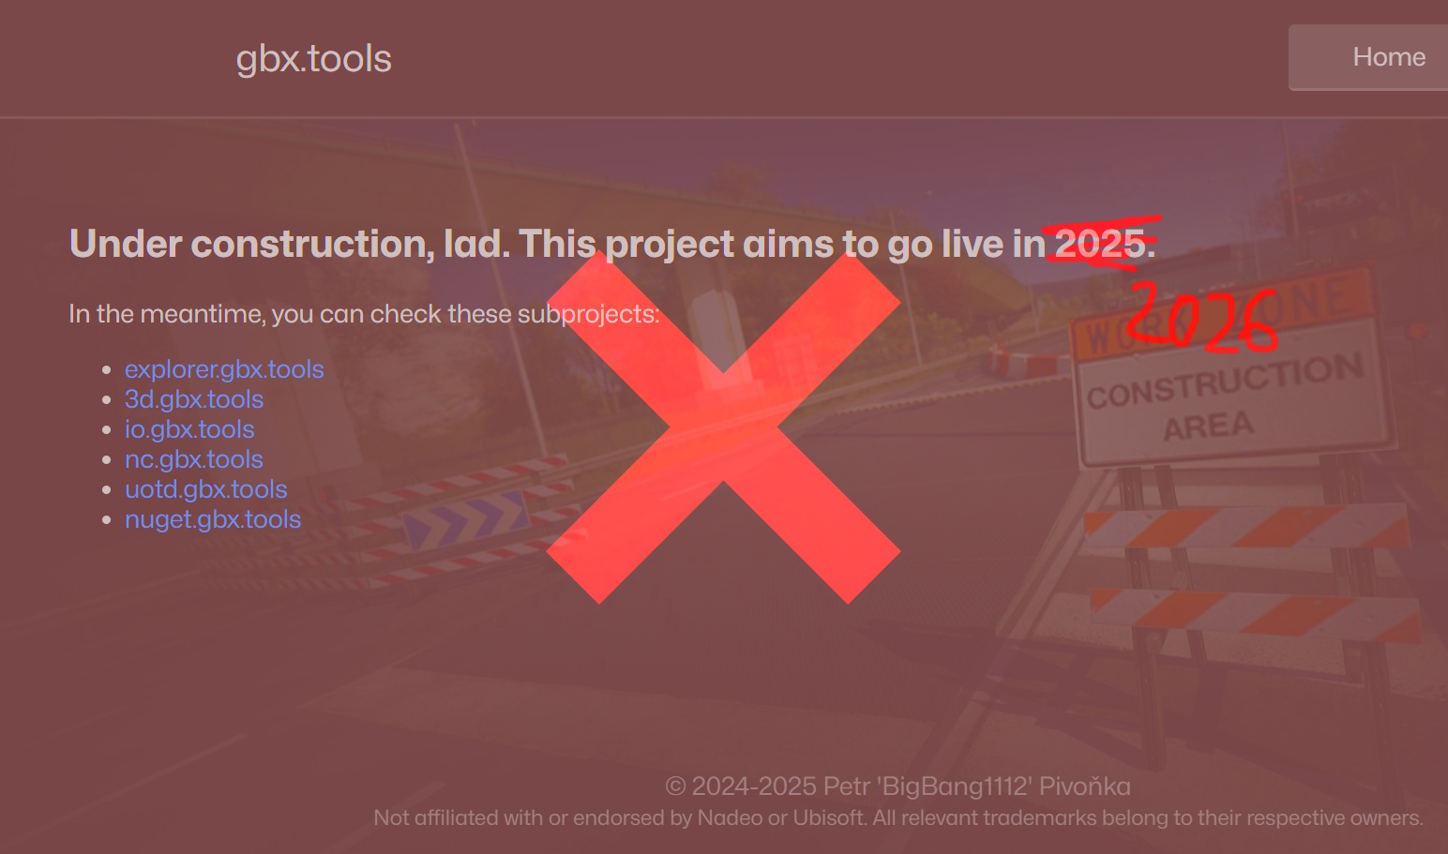

Slide 10
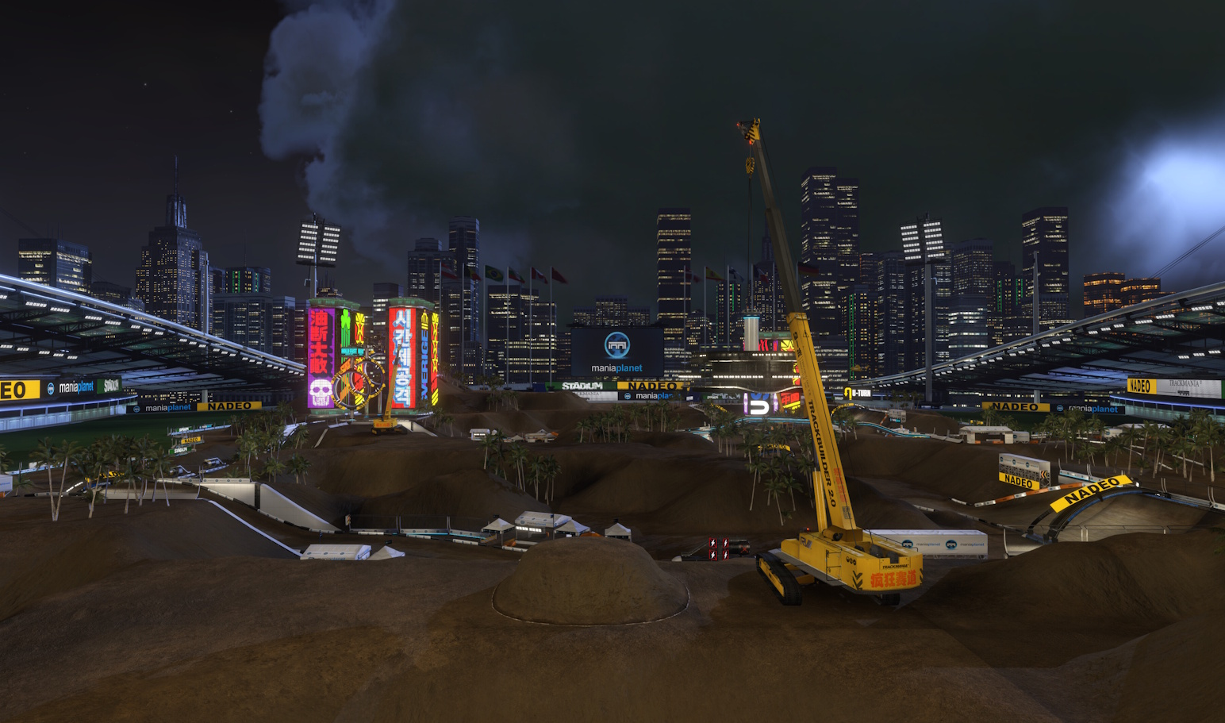

Slide 11
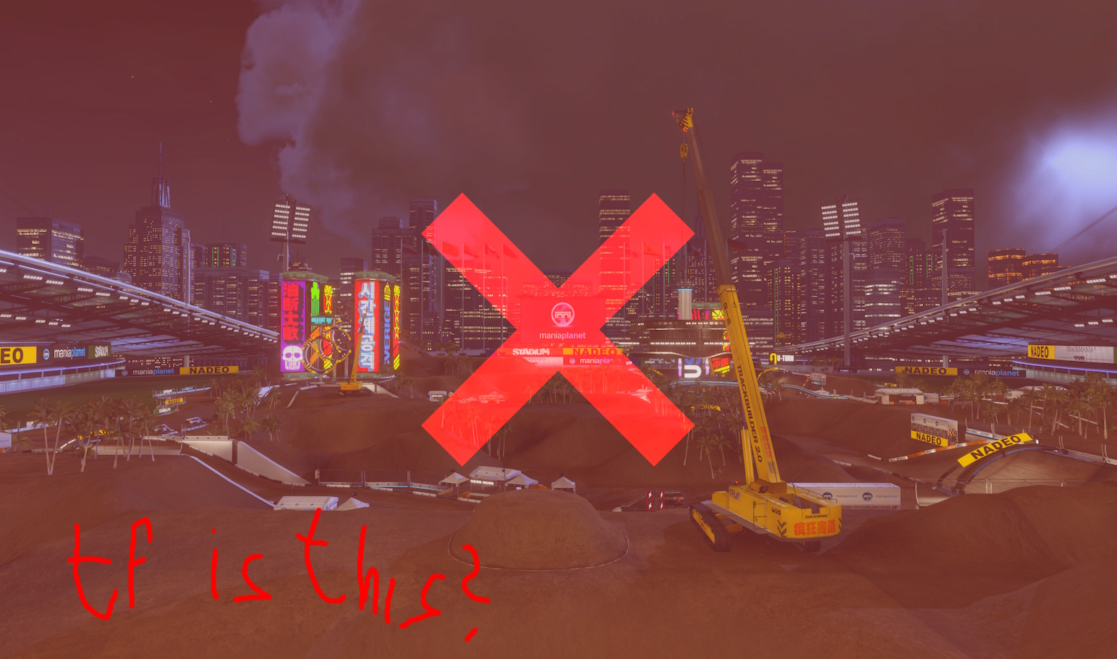

Slide 12
Replay Validation

Slide 13
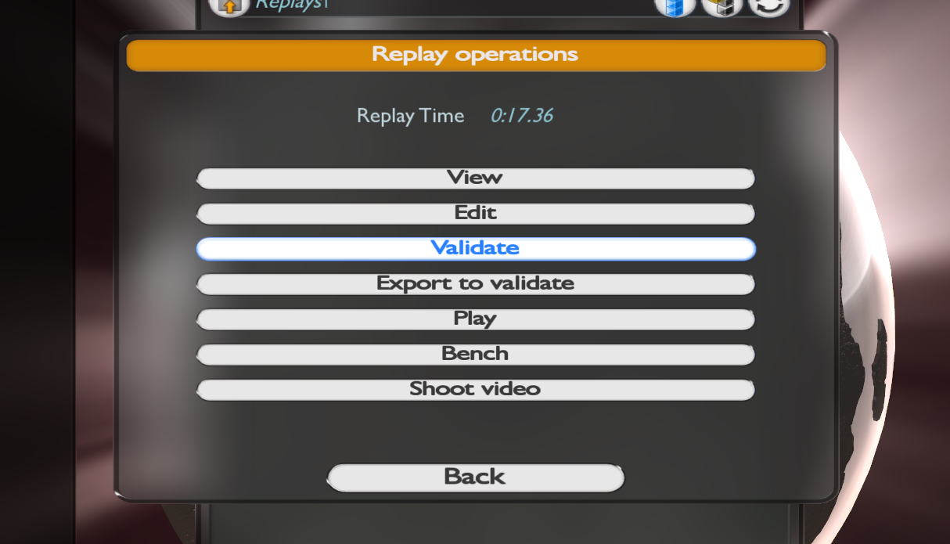

Slide 14
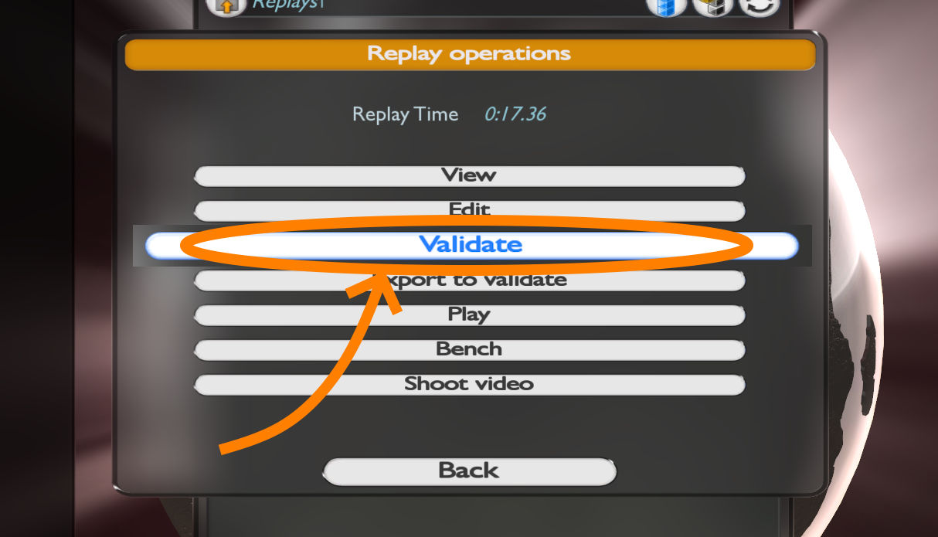

Slide 15
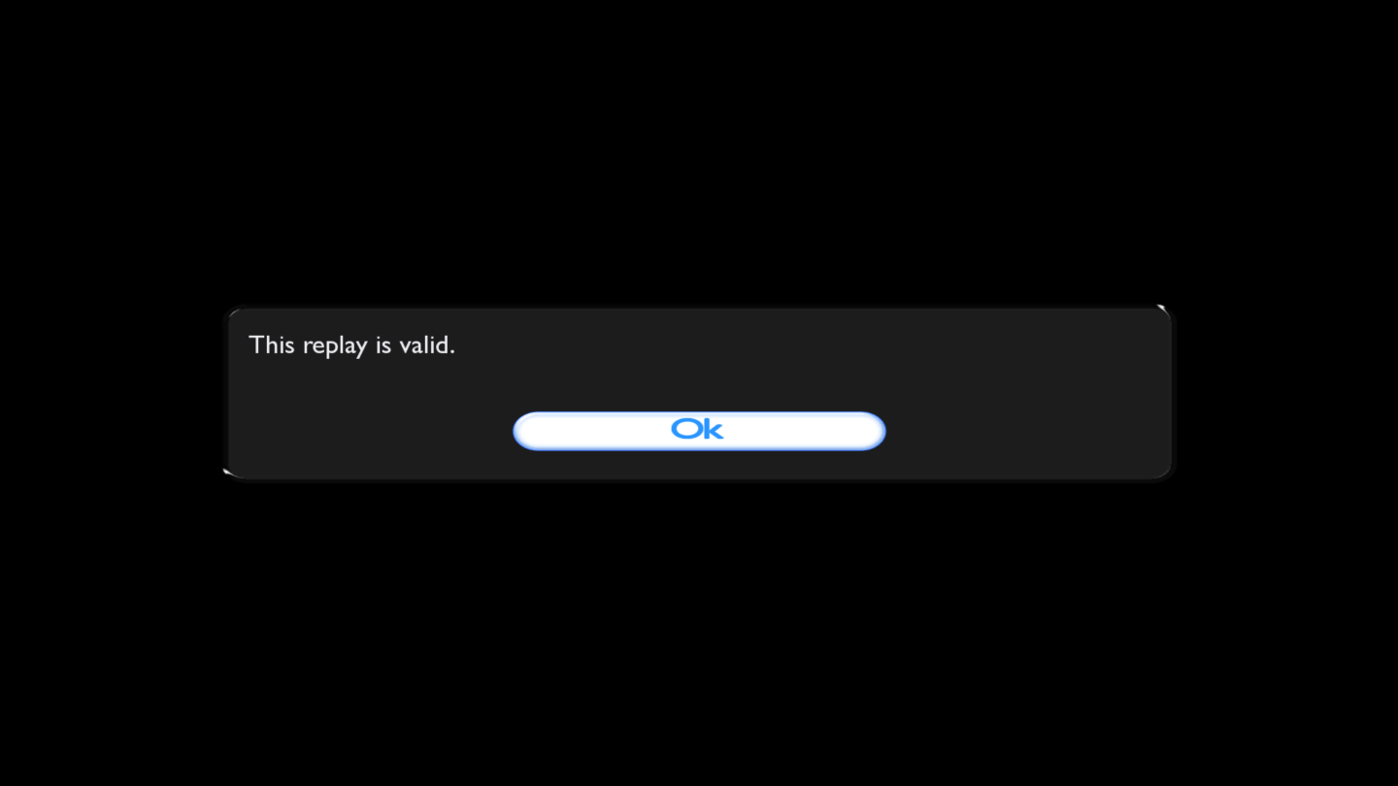

Slide 16
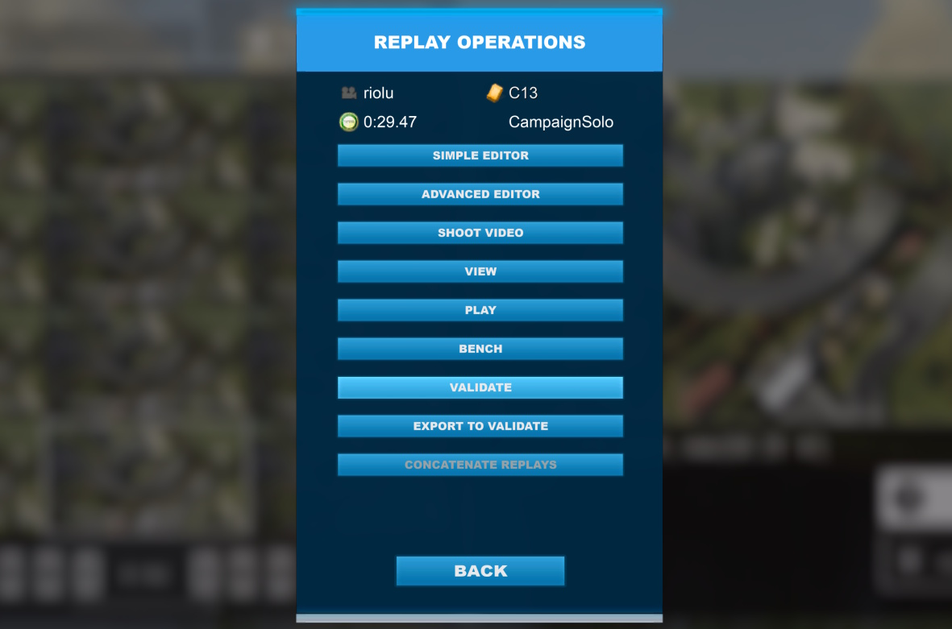

Slide 17
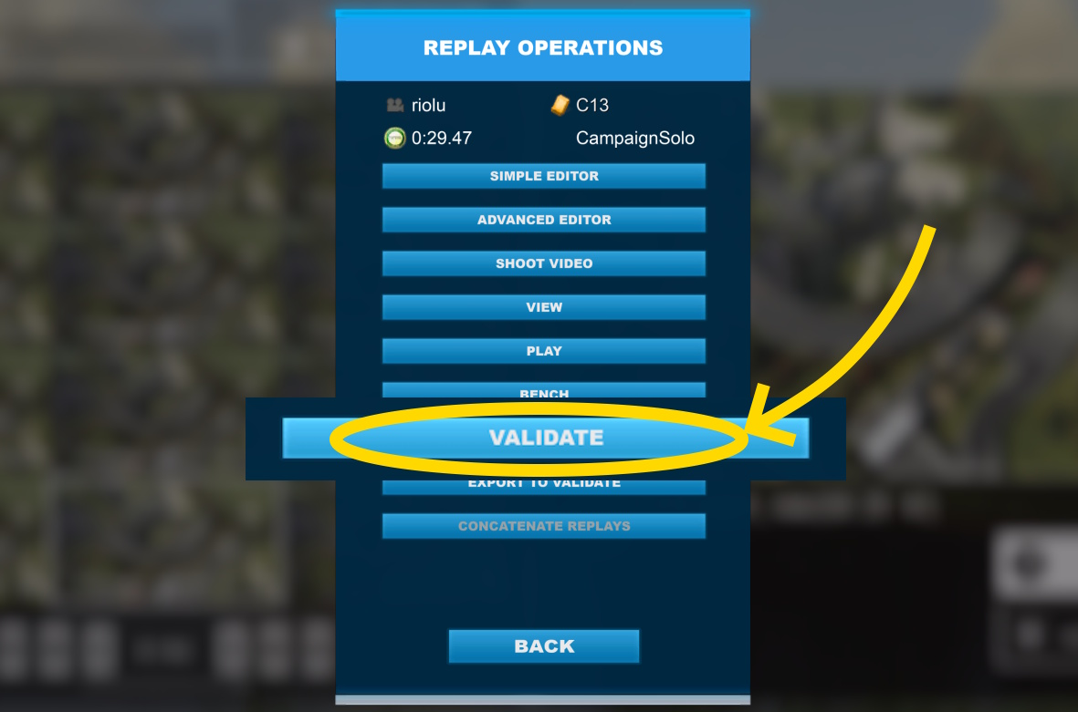

Slide 18
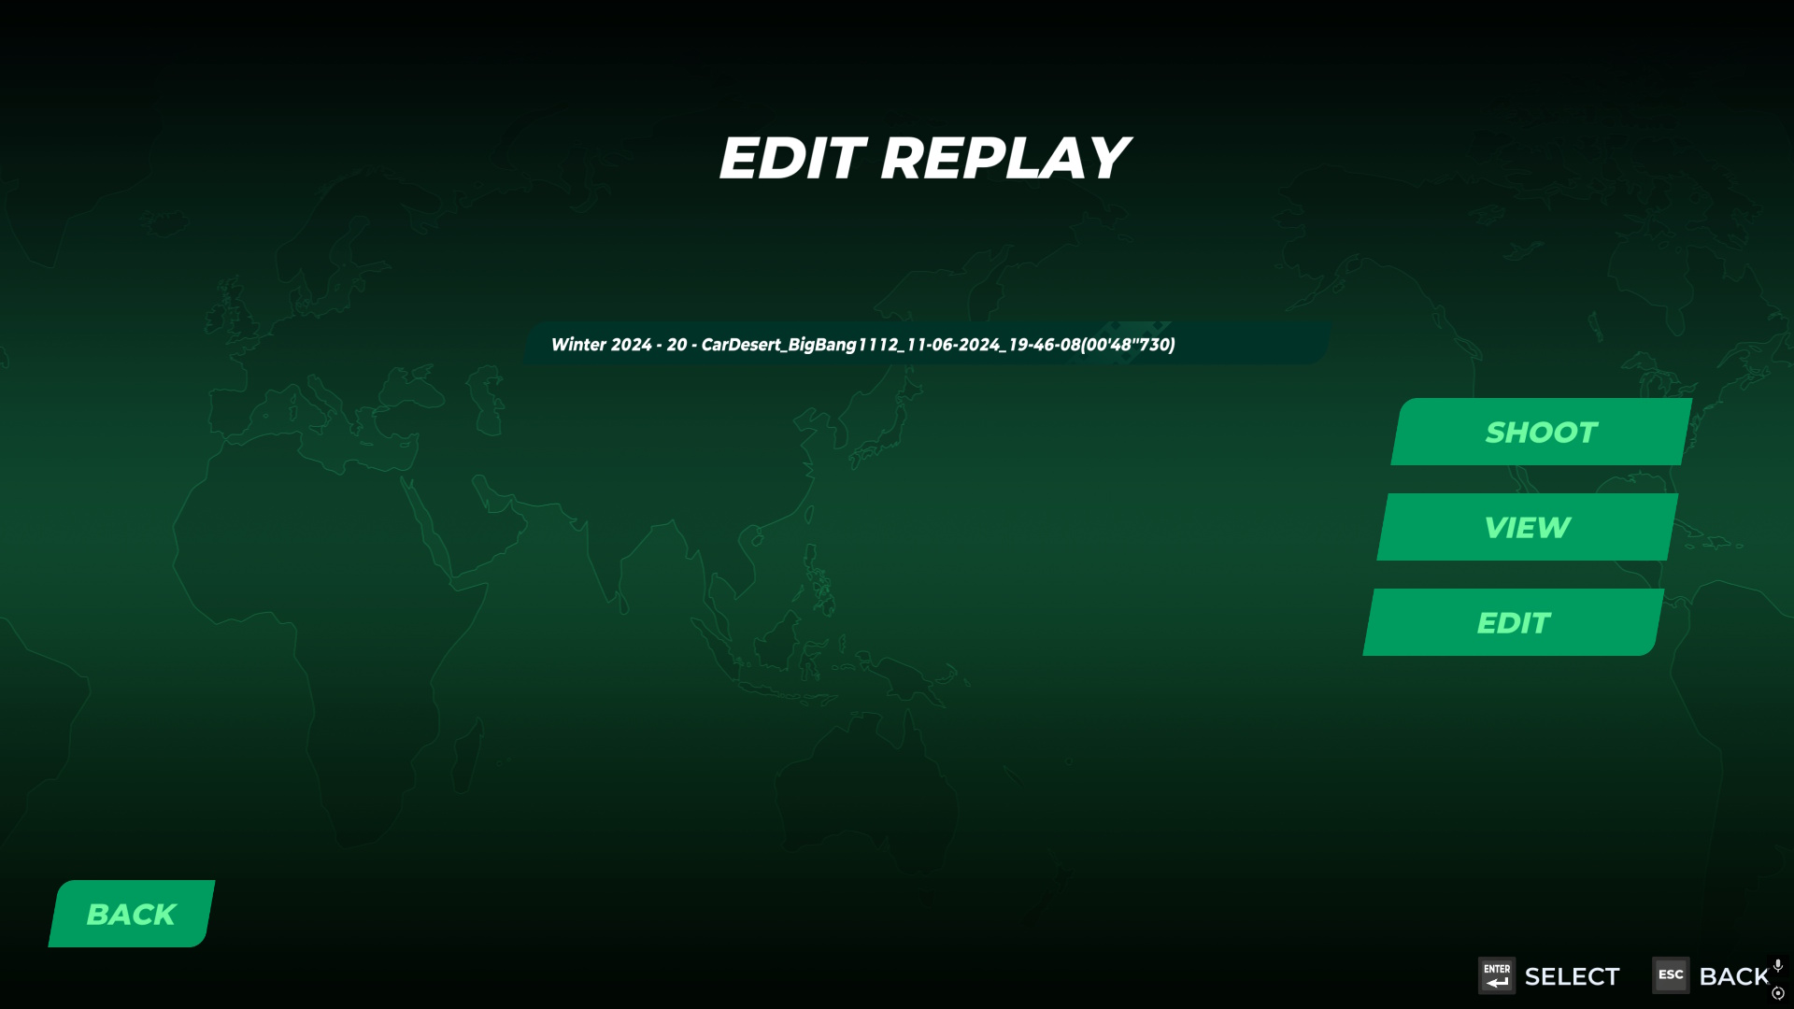

Slide 19
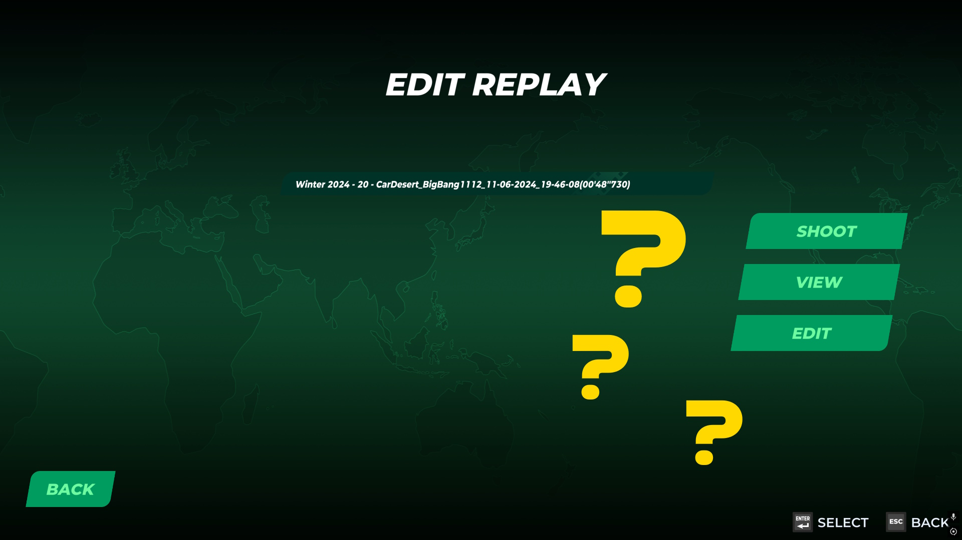

Slide 20
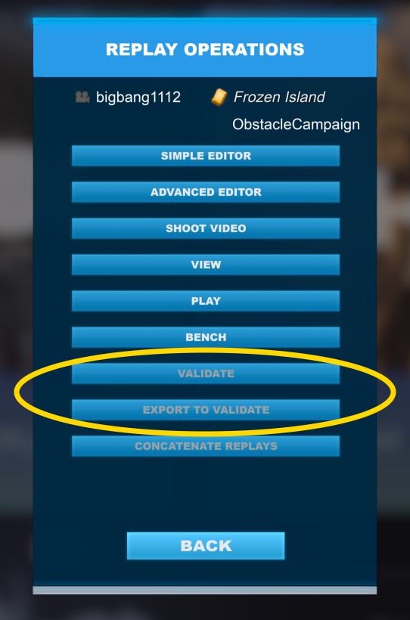
Why not in Trackmania 2020?
Theories:
Based on ShootMania „sub-engine“
Support for multiple start blocks (Royal!)
Pickup items
Collisions
It was never implemented
(or so we thought)

Slide 21
Why is validation important?
Detects vehicle physics tweaks
Detects map edits
Ensures determinism – same inputs give the same result
Existed since 2003!
„BUT you can spot these bad replays right away! Why bother?“
Why do I have to see cheaters in games?

Slide 22
Discovering TM2020 validity
In September 2022 (announced in Decemeber)
Inputs found to be available in TM2020 replay files
Not encrypted, just stored differently
If there are specialized Trackmania inputs stored in replay files,
then there must be something to validate it against.

Slide 23
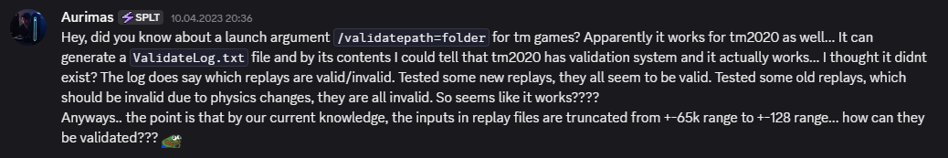
In 2023, Auris discovered that TM2020 has a functioning validation command

Slide 24
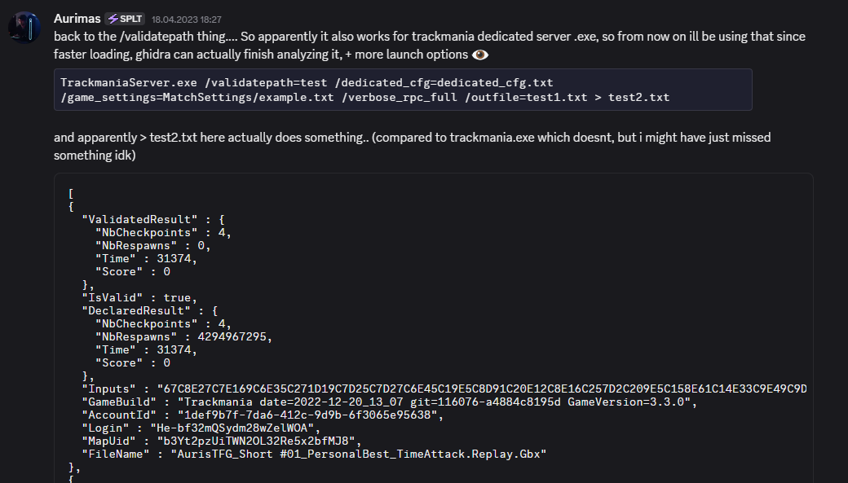
Also working for dedicated servers

Slide 25
What makes replays valid?
Simulation of inputs => same results as replay metadata
Validation executed on a trusted (unmodified) game build
Physics modification should invalidate legitimate replays
Driven in real time? Not really… but there was an attempt!

Slide 26
TM2020 validation is weird

Slide 27
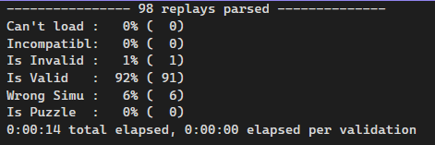
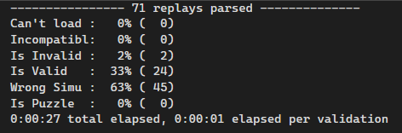
Was 2021 invalid?
In Winter 2021, validation slightly broke…
In Spring 2021, validation broke a lot…
Winter 2021 - 01: Top 100 ghosts
Spring 2021 - 01: Top 100 ghosts

Slide 28
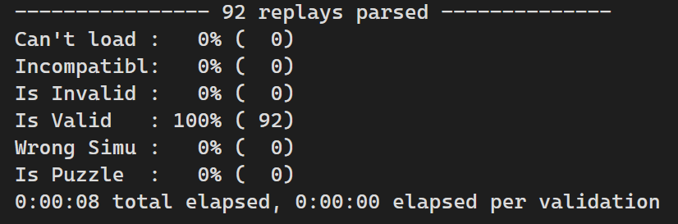
For comparison: Fall 2020 - 01

Slide 29
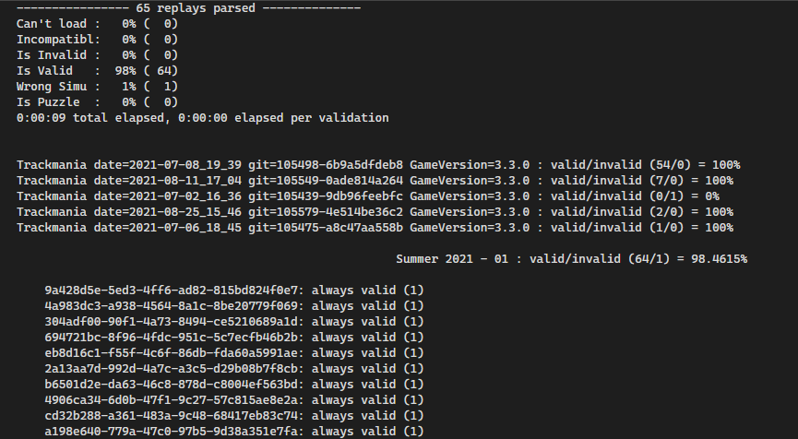
Walltime as a solution to slow motion?
In Summer 2021, after the cheating scandal…
TM2020 began storing walltime (clock/real time) in a replay file
Replays are valid again!

Slide 30
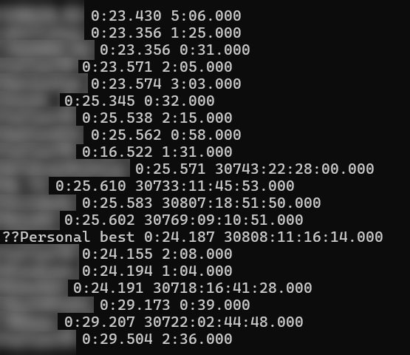
Walltime as a solution to slow motion?
32bit timestamps!!! TM2020 will break in 2038…
I compared race time with walltime just to see…
~5% of runs had broken walltime
Format: [map+player] [race time] [walltime]

Slide 31
84.3% game speed!
72.5% game speed!
(something might not work here…)

Slide 32
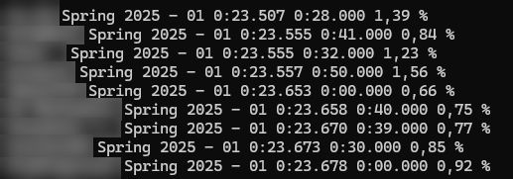
Spring 2023+
Validation has stabilized
~1% of runs still have broken walltime

Slide 33
How to bring validation to players again?

Slide 34
Dedicated servers for validation I/O?
/validatepath
The only available way in TM2020
Works for TM2 as well
Not working:
TMForever – not available on dedicated servers
TMTurbo – no dedicated severs

Slide 35
So how to unify it and make it usable?

Slide 36


Slide 37
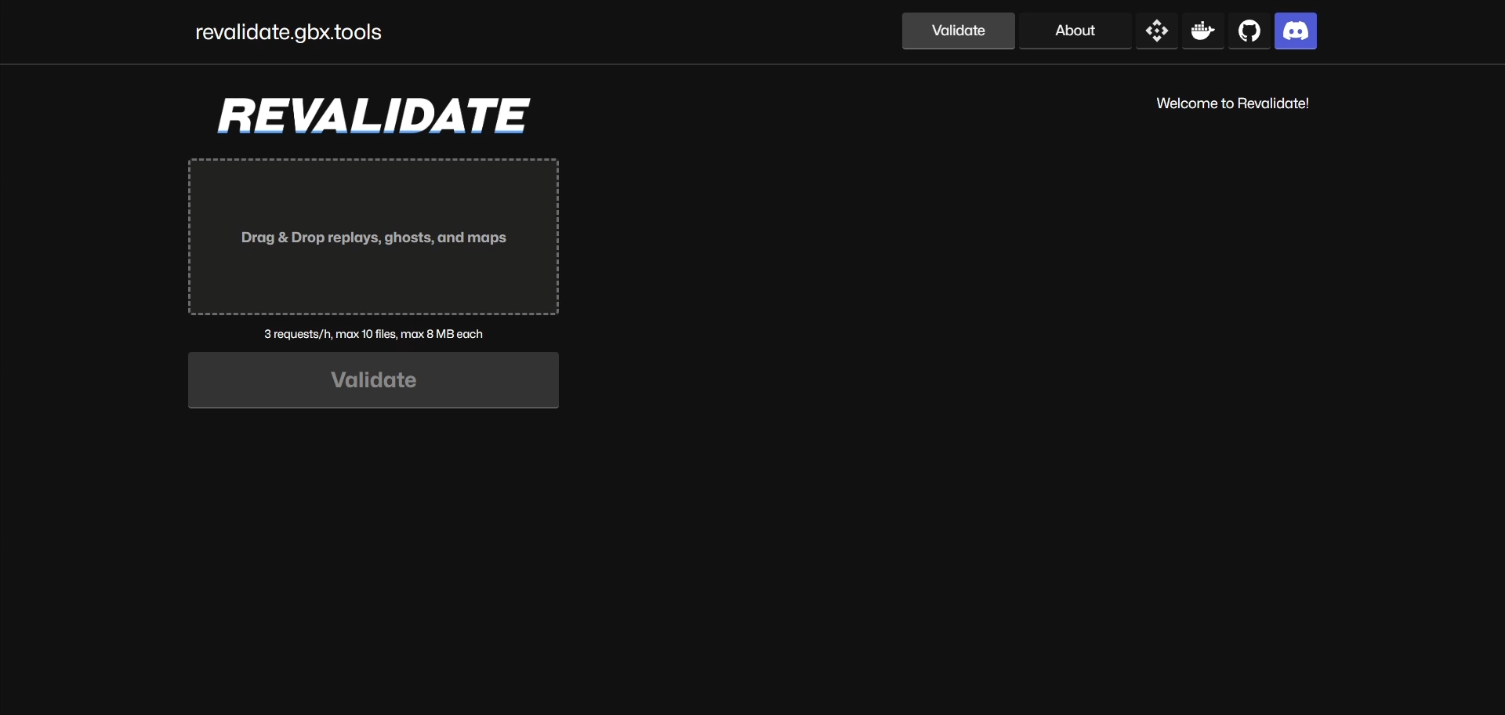

Slide 38
Why multiple Linux distributions?

Slide 39
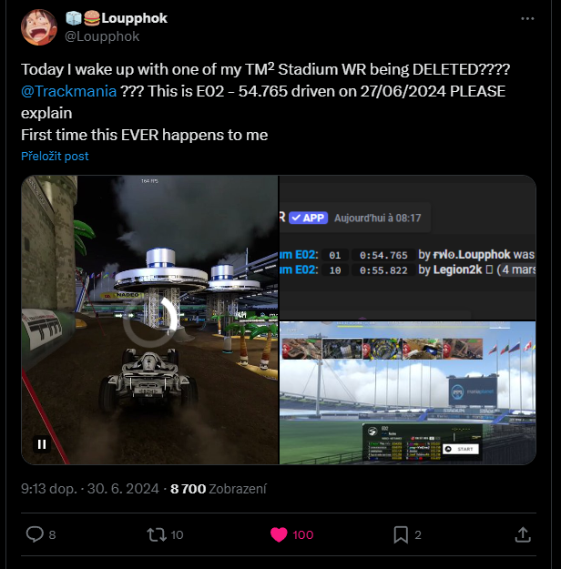

Slide 40
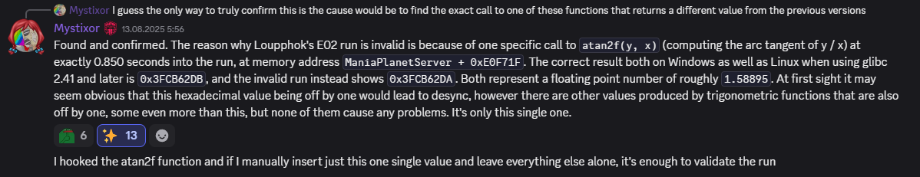
Long story short
Nadeo automatically validates Top 10 in Trackmania 2
Loupphok‘s run was invalid only on some Linux distros
One of which Nadeo uses (Ubuntu 14)
Mystixor found a bug in the atan2f() function of glibc library
The bug was 30+ years old, fixed just about a year ago in glibc 2.40

Slide 41
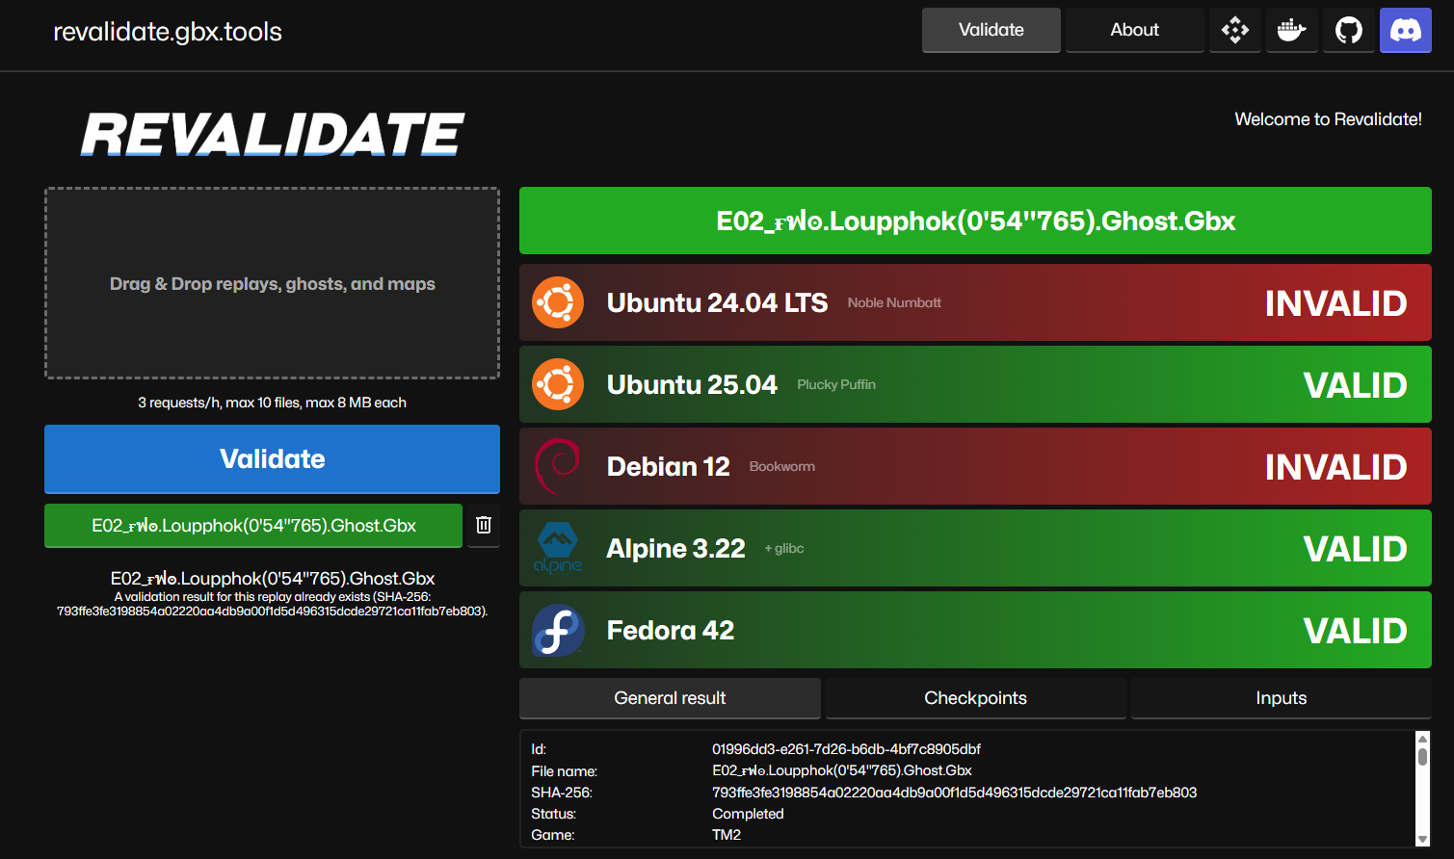

Slide 42
What about TMUF (and TMTurbo)?

Slide 43
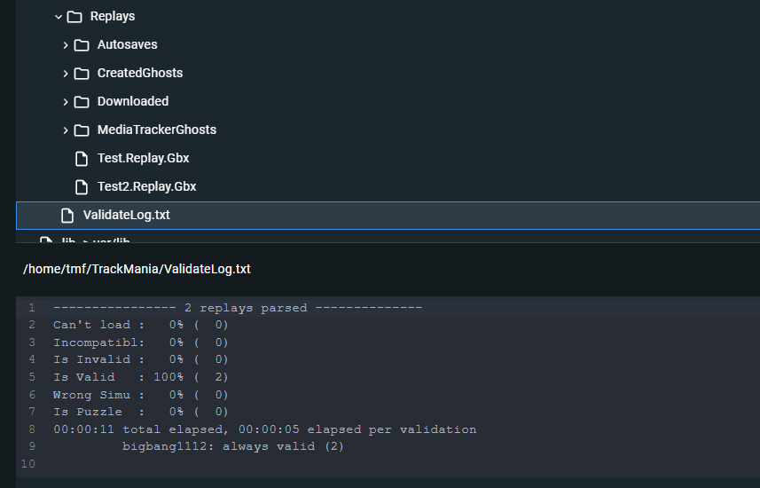

Slide 44
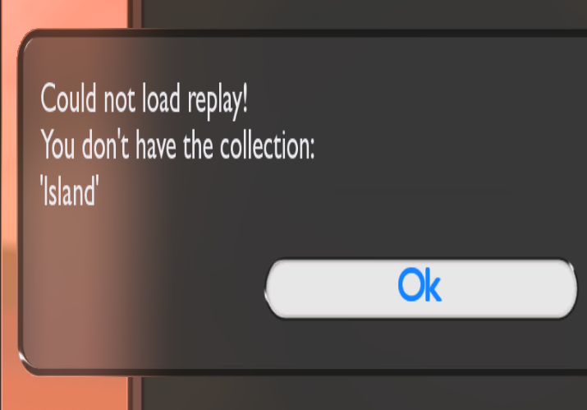
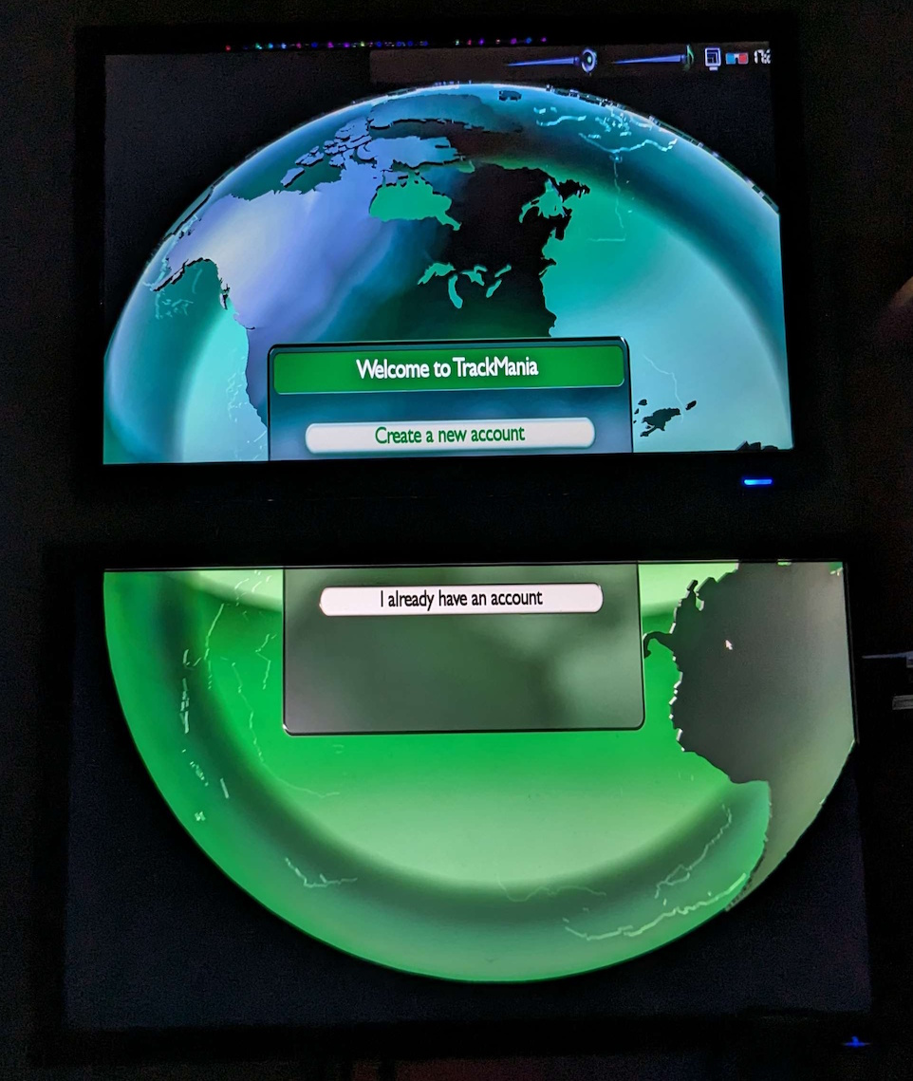
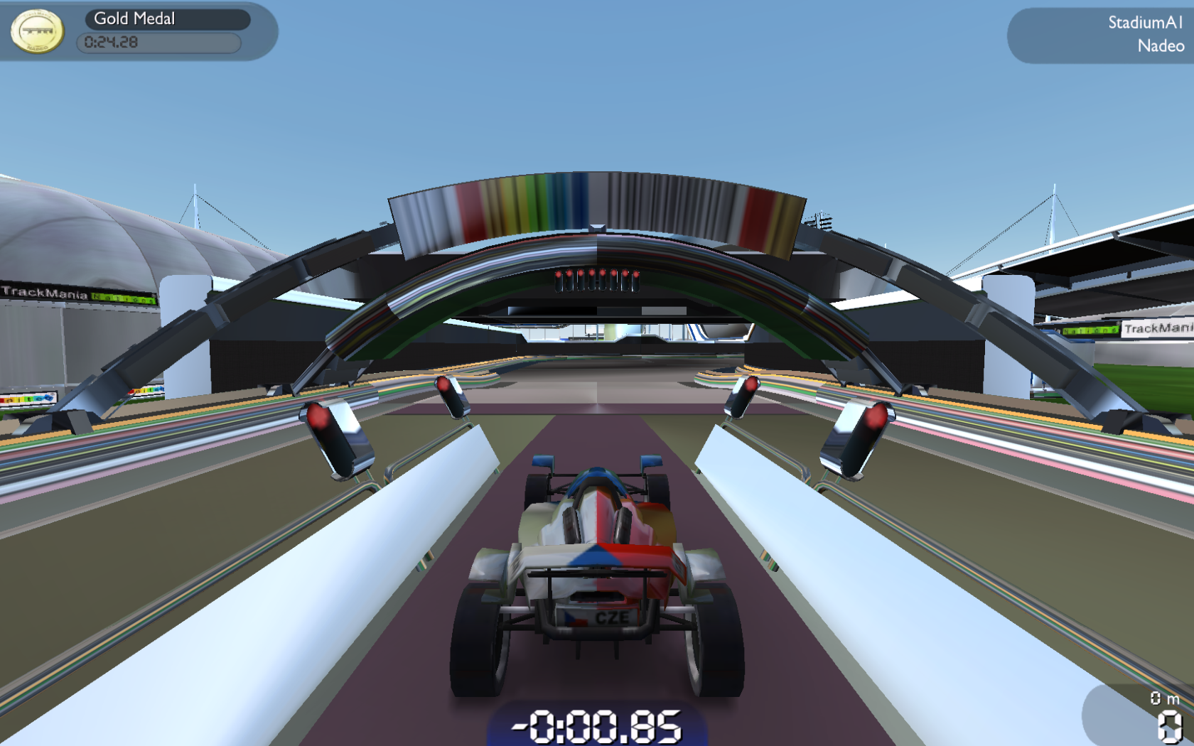
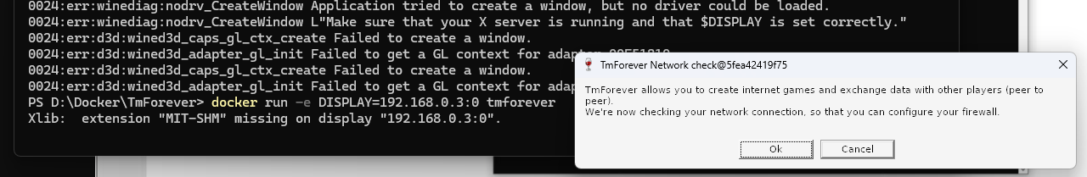

Slide 45
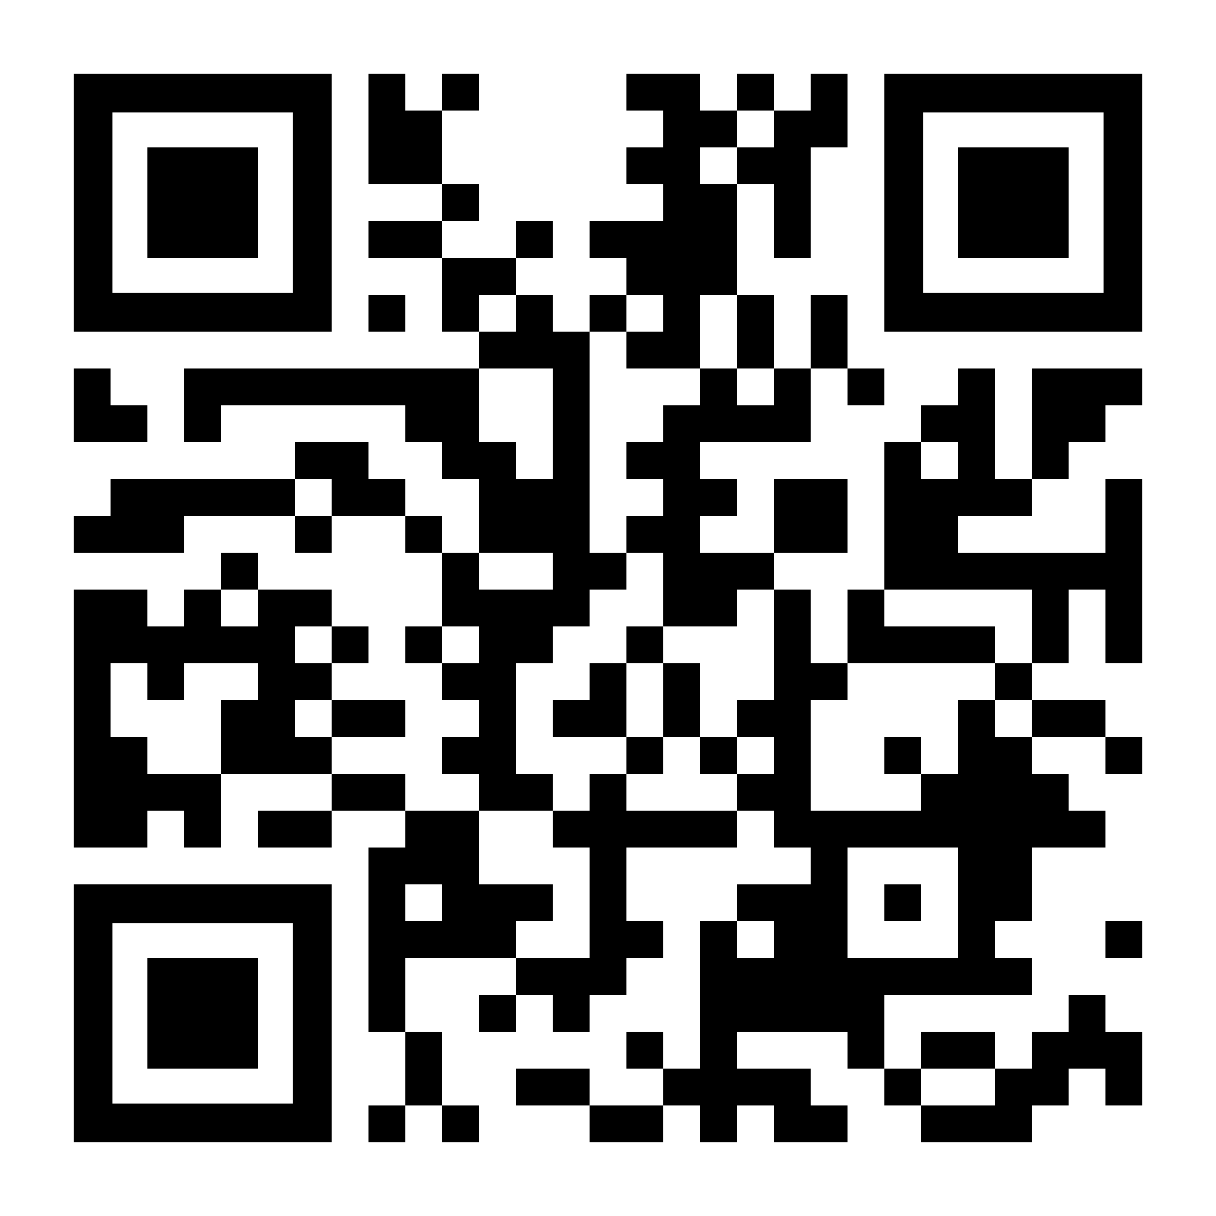
revalidate.gbx.tools

Slide 46
